Slide 1


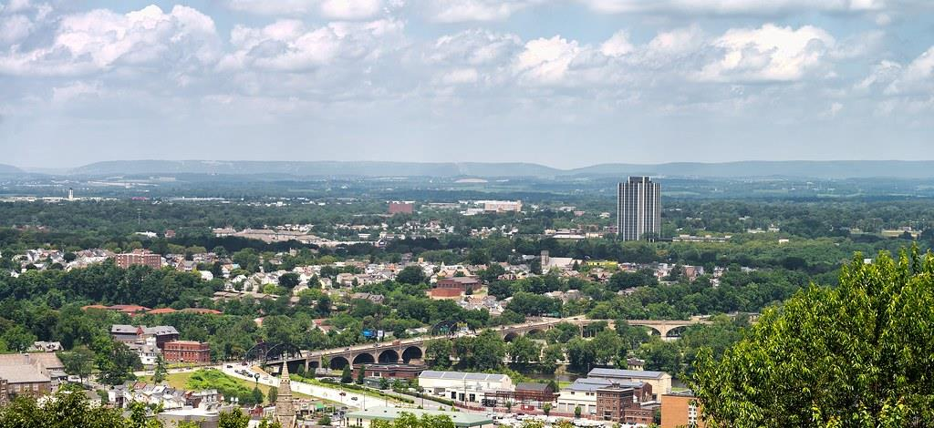
DIRECT-TO-EMPLOYER PLAN
September 25, 2024

Slide 2



Founded in 1979 and headquartered in Indianapolis, IN​
Full-service TPA specializing in the administration of self-funded health plans and population health management​
One of the country’s largest independently-owned TPAs
The Key Family is a commonly-held group of benefits related organizations with:​
3,000+ corporate clients​
3.0 million members under management​
700 Employees
Exclusive Relationships
We know The Market – Agents, Networks, and MGAs

Slide 3


Healthcare Leader in Private Labeled DTE Plans
Louisville, KY
OneHealth Plan
Cincinnati, OH
TCH Optimal
Bentonville, AR
Northwest Health Plan
Knoxville, TN
East Tennessee Health Plan
Meridian, MS
Affinity Health Plan
Fort Myers, FL
Lee Health Care Partners

Slide 4

Direct-to-Employer (DTE) Your plan focused on Your relationship with Employers
YOU Pick the Name of the Health Plan
YOU Determine the Fees Charged
YOU Practice the Medicine
YOU Receive the Profits
WE Make it Successful

Slide 5



Direct-to-Employer Strategy: Increased Capture of Commercial Market Share
SLUHN DTE
PPO #1
PPO #2
PPO #3

Slide 6
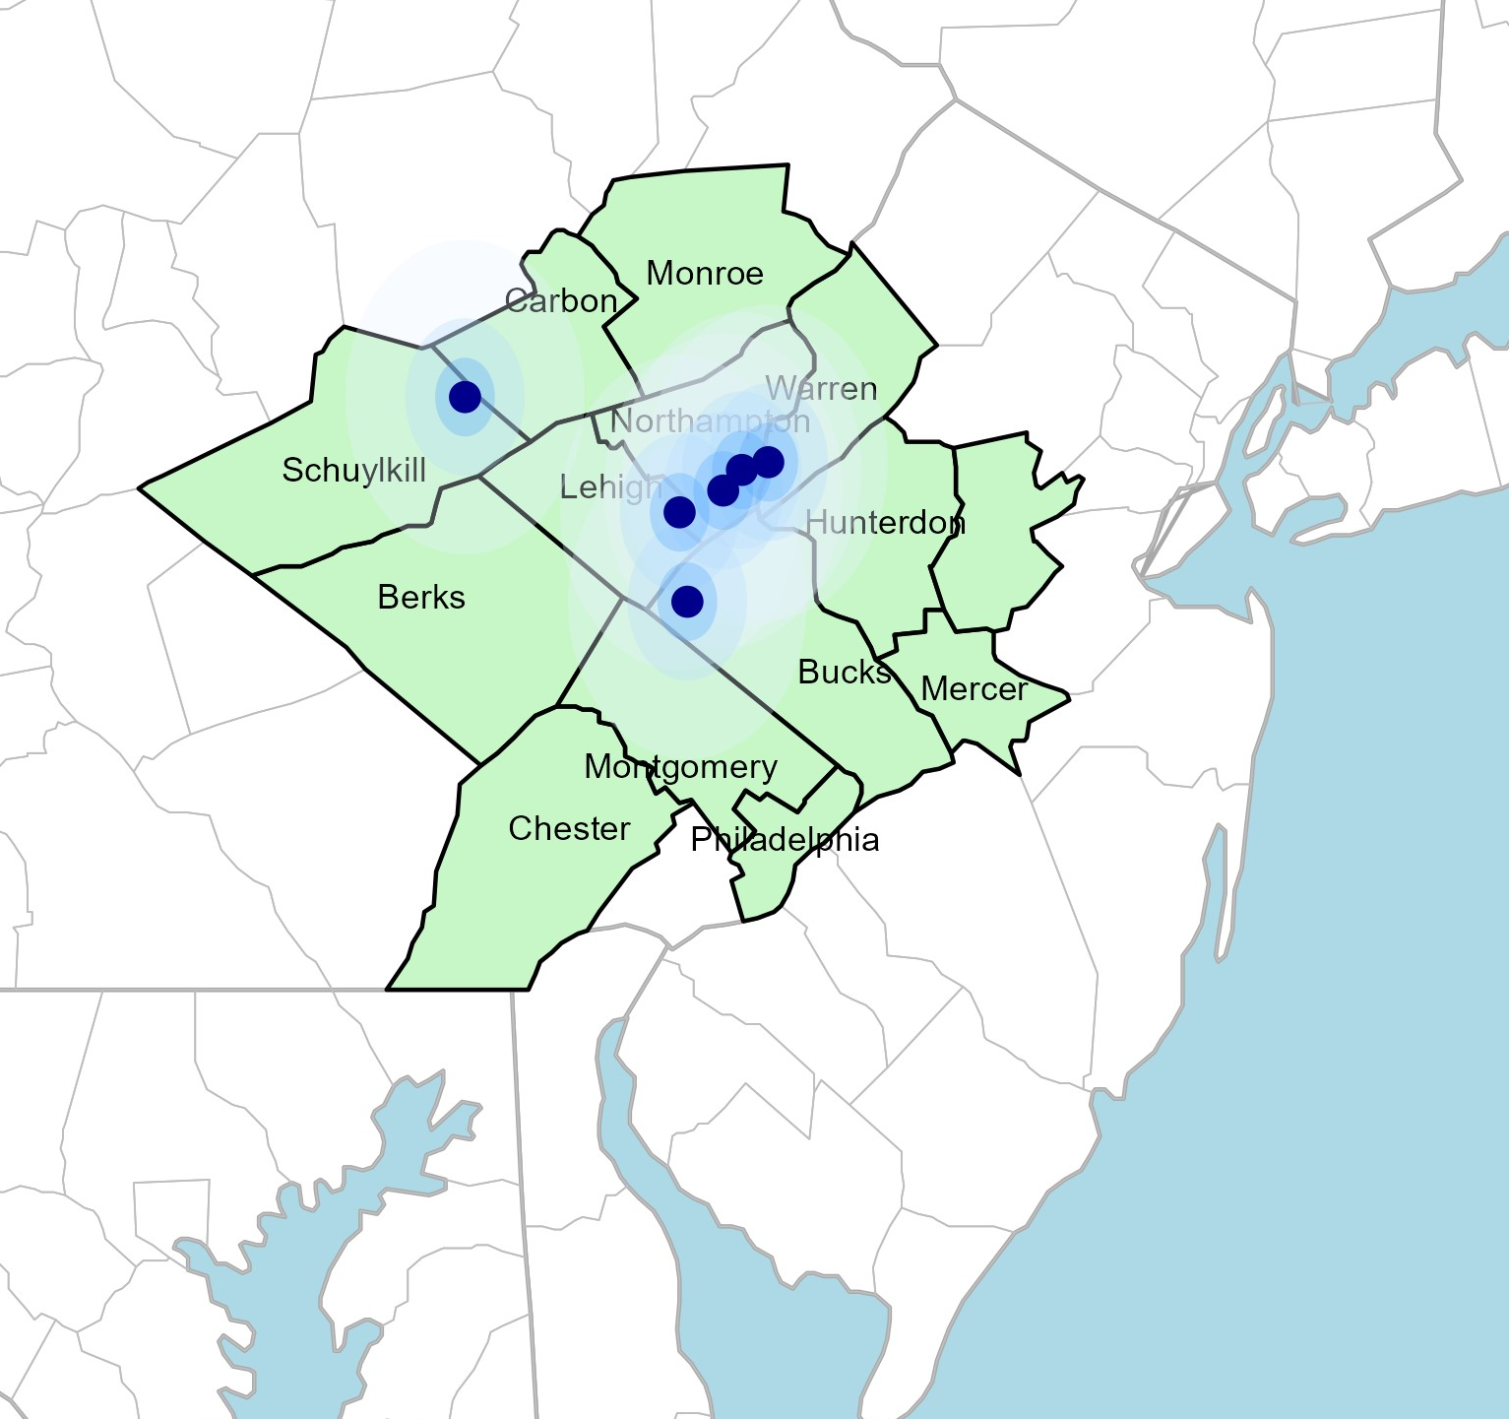
Significant Opportunity for SLUHN
Target Market 2,353 Employers 390,000+ Employees 627,000+ Members
 | Total Employees
Commercial Employers With Headquarters: | 50-100 | 101-200 | 201-400 | 401-1000 | 1001-3000 | 3000+
Within 10 Miles of SLUHN Hospital | 552 | 261 | 161 | 73 | 13 | 15
Within 11-20 Miles of SLUHN Hospital | 767 | 278 | 175 | 86 | 24 | 10
Within 21-30 Miles of SLUHN Hospital | 1908 | 775 | 544 | 290 | 105 | 75
Employees at Above Firms | 50-100 | 101-200 | 201-400 | 401-1000 | 1001-3000 | 3000+
Within 10 Miles of SLUHN Hospital | 41,400 | 39,150 | 48,300 | 51,100 | 26,000 | 165,000
Within 11-20 Miles of SLUHN Hospital | 57,525 | 41,700 | 52,500 | 60,200 | 48,000 | 110,000
Within 21-30 Miles of SLUHN Hospital | 143,100 | 116,250 | 163,200 | 203,000 | 210,000 | 825,000
Total Members at Firms | 50-100 | 101-200 | 201-400 | 401-1000 | 1001-3000 | 3000+
Within 10 Miles of SLUHN Hospital | 66240 | 62640 | 77,280 | 81,760 | 41,600 | 264,000
Within 11-20 Miles of SLUHN Hospital | 92040 | 66720 | 84,000 | 96,320 | 76,800 | 176,000
Within 21-30 Miles of SLUHN Hospital | 228960 | 186000 | 261,120 | 324,800 | 336,000 | 1,320,000

Slide 7
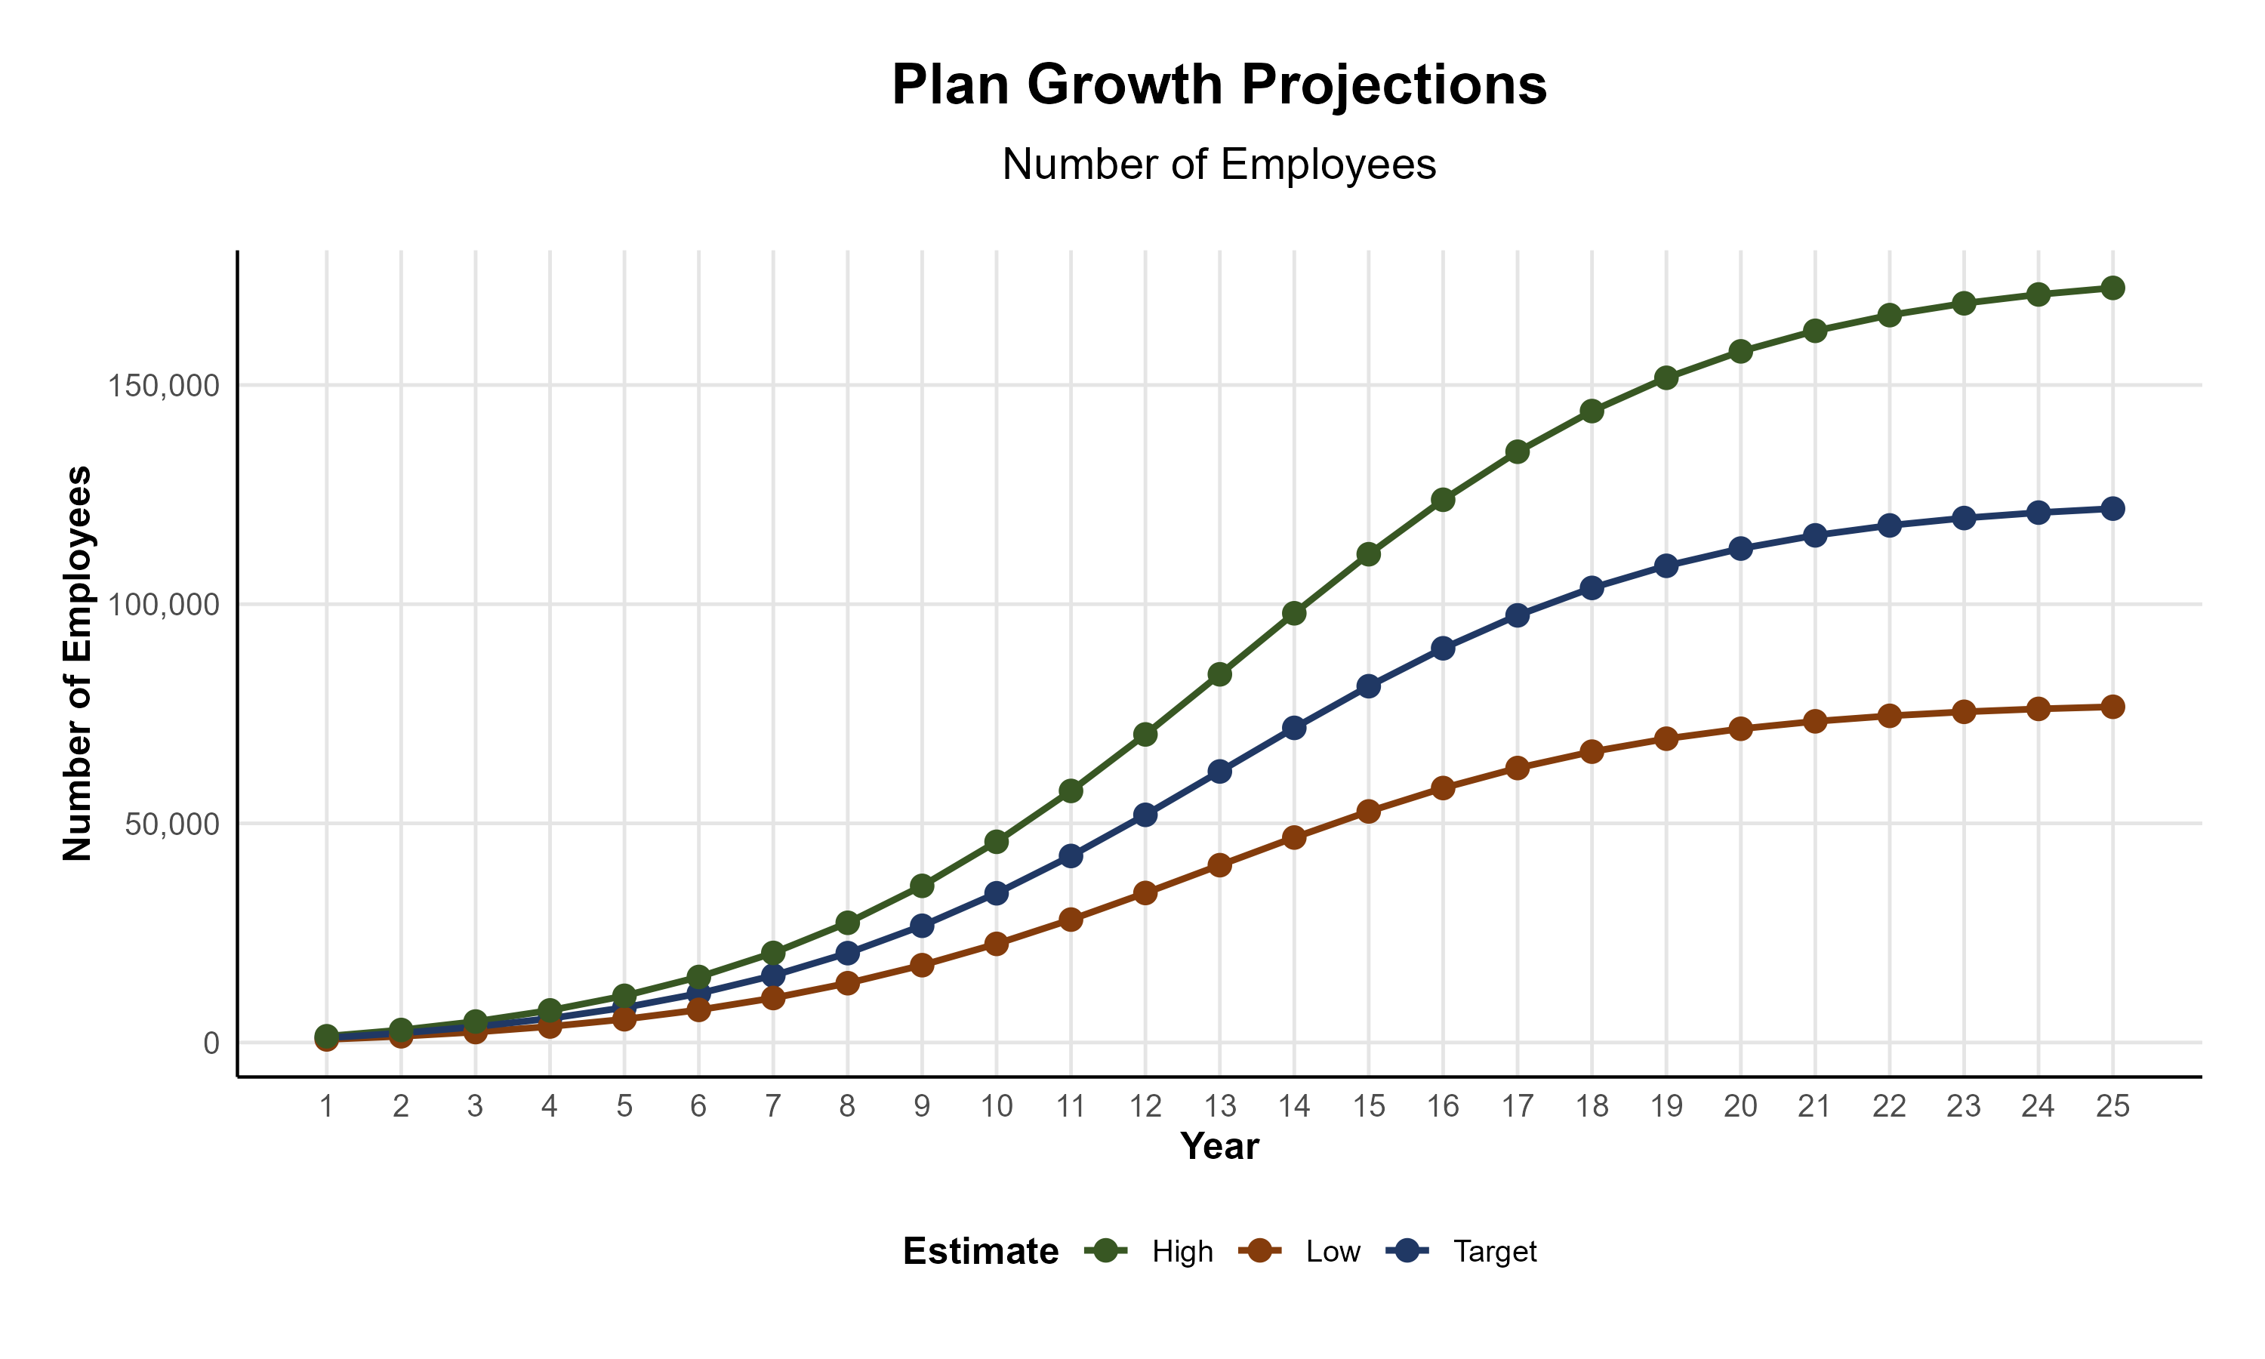
Plan Potential Growth Paths
Self Funded
538K
PLAN GROWTH POTENTIAL
935K
Insured
Working Age
1,230K
Population
2,106K
Estimates include Hunterdon, Warren, Bucks, Carbon, Lehigh, Luzerne, Northampton, and Schuylkill Counties

Slide 8

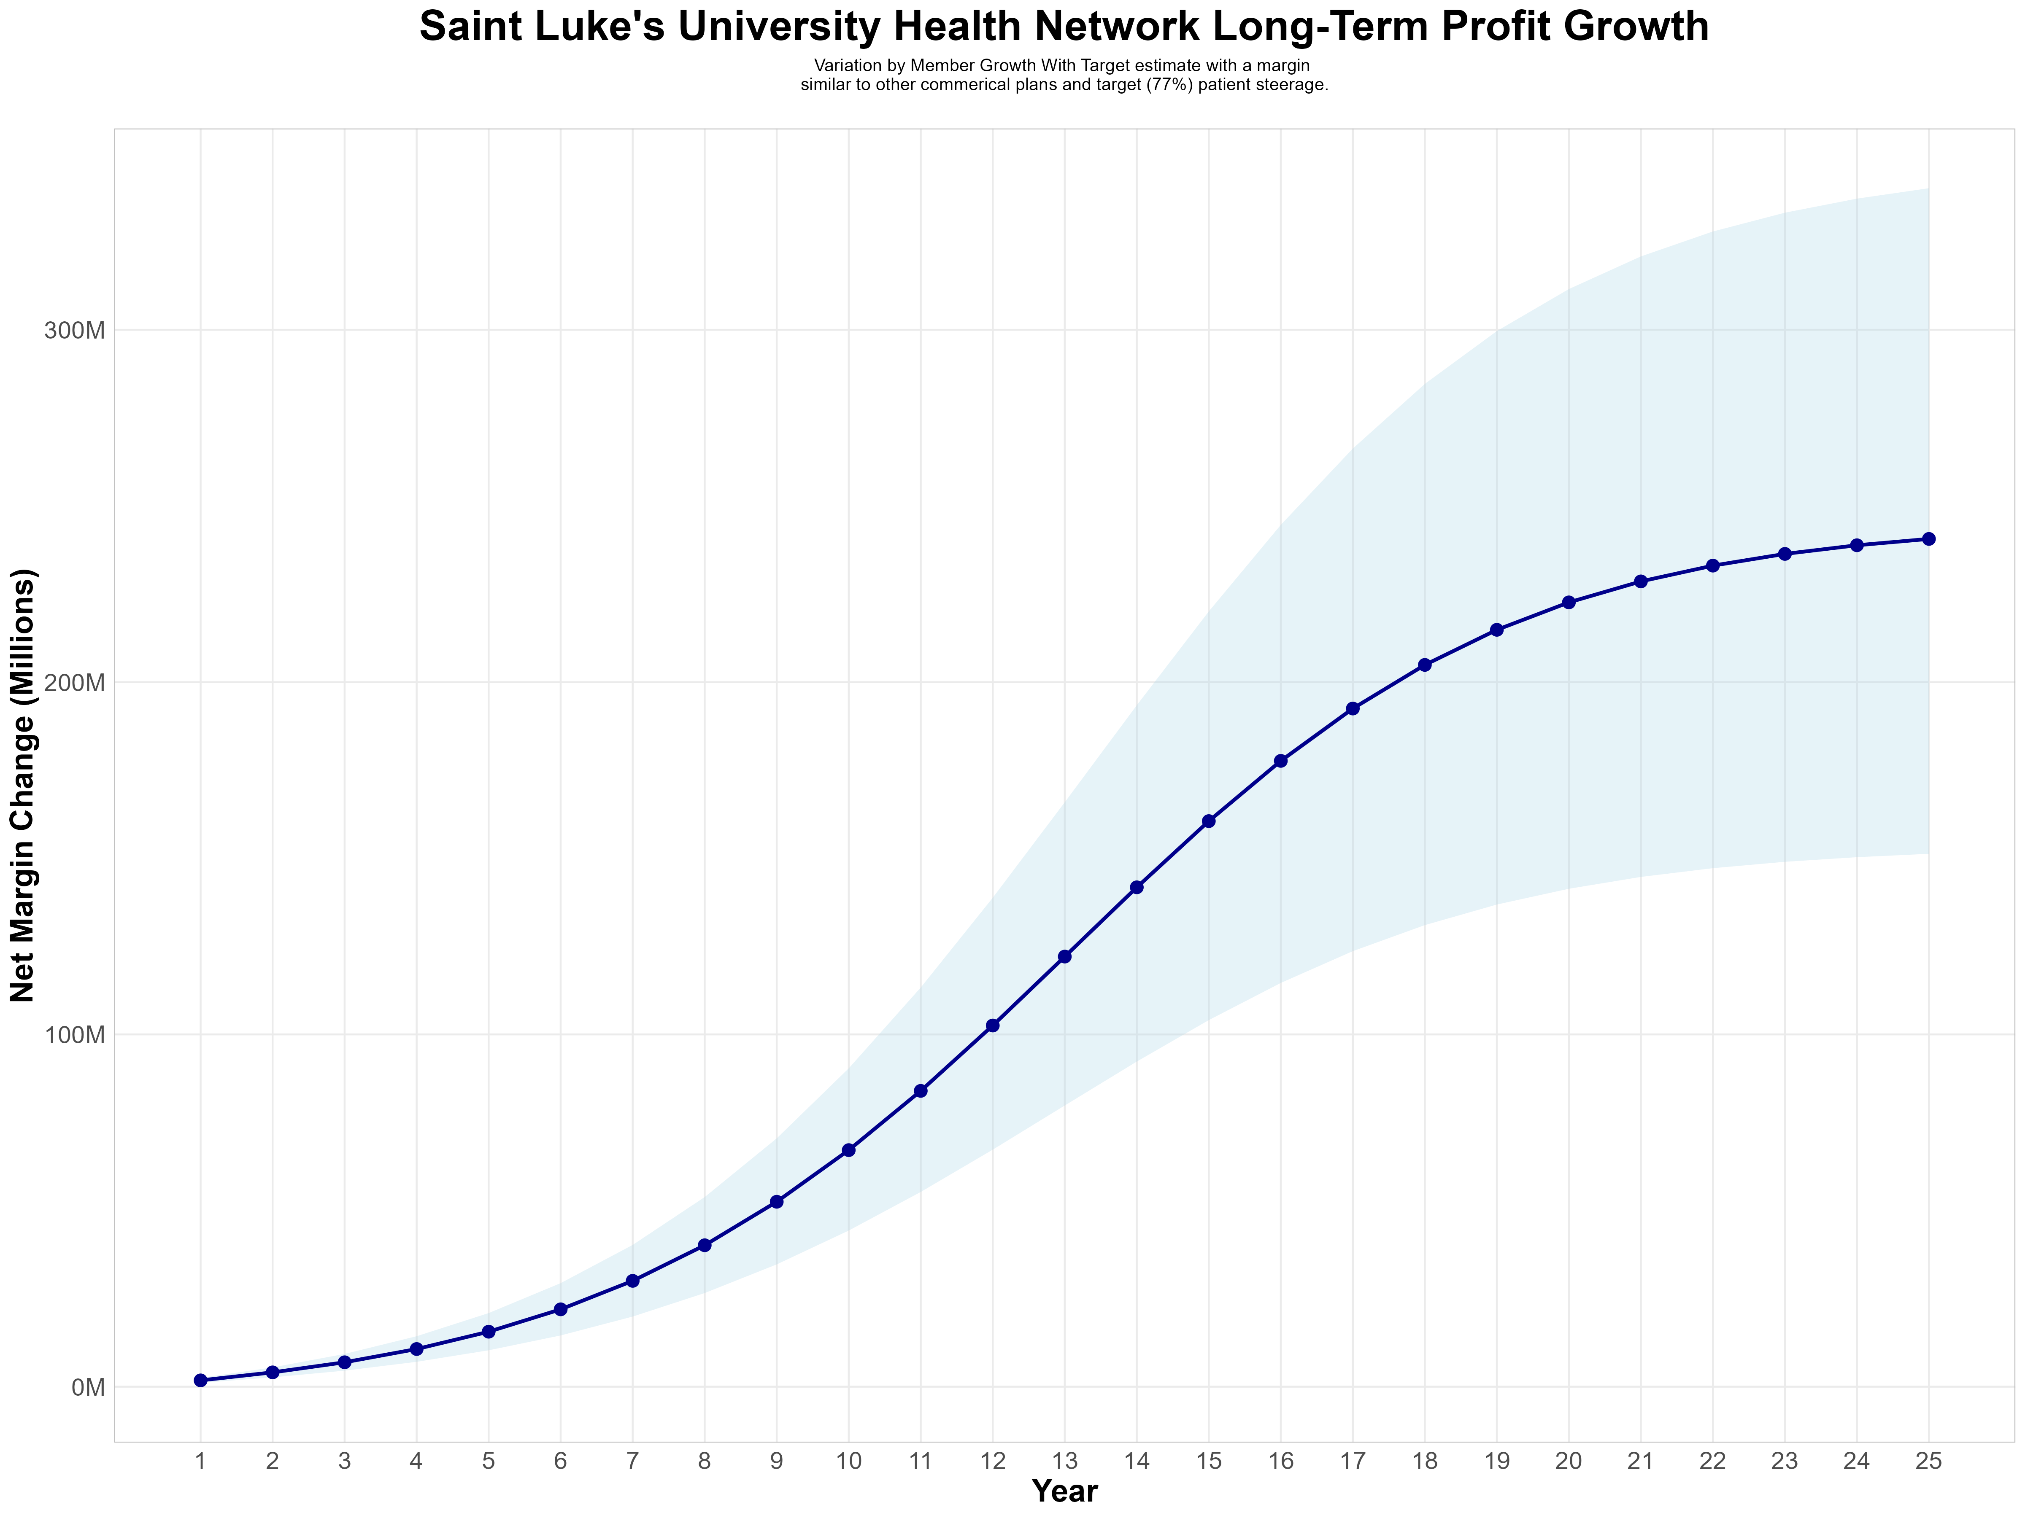
Growing Powerful, Lasting Profitability
Early Stage
Graining Name Recognition, Early Growth
New Revenue:
New Profit:
$63.33M
$16.41M
Growth Stage
Strong Reputation, Strong Growth
New Revenue:
New Profit:
$433.64M
$113.52M
Mature Stage
High Profitability, Market Saturation
New Revenue:
New Profit:
$853.45M
$223.6M

Slide 9
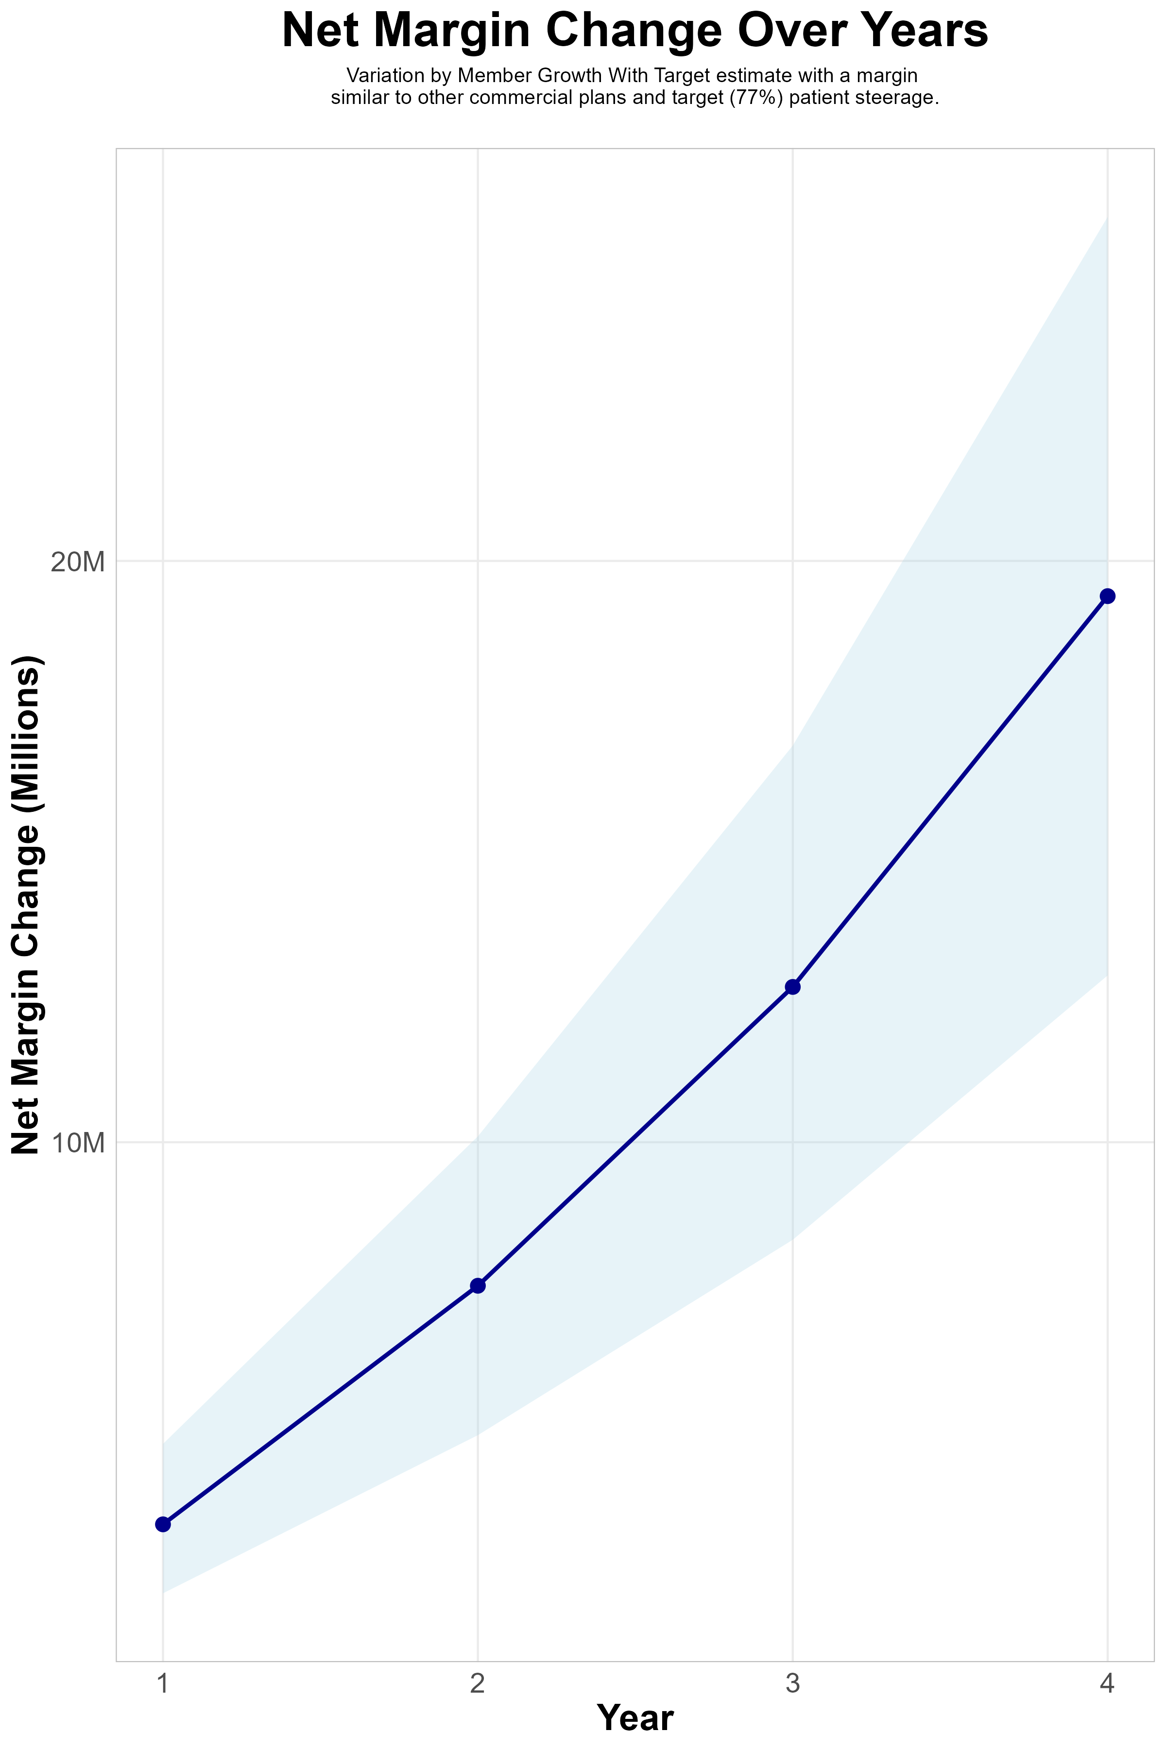
FOUR-YEAR PROJECTIONS
Target Member Growth | Target Member Growth | Target Member Growth | Target Member Growth | Target Member Growth
Metric | Year 1 | Year 2 | Year 3 | Year 4
Number of Members | 1,900 | 3,900 | 6,500 | 9,900
Incremental Margin | 3,733.8K | 7,664.2K | 12,773.7K | 19,455.3K
Network Access Fee | 22.8K | 46.8K | 78.0K | 118.8K
Implementation Fee (One-Time) | -150.0K | 0.0K | 0.0K | 0.0K
Sales and Marketing Costs | -180.0K | -180.0K | -180.0K | -180.0K
Net Margin Change | 3,426.6K | 7,531.0K | 12,671.7K | 19,394.1K
High Member Growth | High Member Growth | High Member Growth | High Member Growth | High Member Growth
Metric | Year 1 | Year 2 | Year 3 | Year 4
Number of Members | 2,600 | 5,200 | 8,600 | 13,200
Incremental Margin | 5,109.5K | 10,218.9K | 16,900.6K | 25,940.4K
Network Access Fee | 31.2K | 62.4K | 103.2K | 158.4K
Implementation Fee (One-Time) | -150.0K | 0.0K | 0.0K | 0.0K
Sales and Marketing Costs | -180.0K | -180.0K | -180.0K | -180.0K
Net Margin Change | 4,810.7K | 10,101.3K | 16,823.8K | 25,918.8K
Low Member Growth | Low Member Growth | Low Member Growth | Low Member Growth | Low Member Growth
Metric | Year 1 | Year 2 | Year 3 | Year 4
Number of Members | 1,300 | 2,600 | 4,300 | 6,600
Incremental Margin | 2,554.7K | 5,109.5K | 8,450.3K | 12,970.2K
Network Access Fee | 15.6K | 31.2K | 51.6K | 79.2K
Implementation Fee (One-Time) | -150.0K | 0.0K | 0.0K | 0.0K
Sales and Marketing Costs | -180.0K | -180.0K | -180.0K | -180.0K
Net Margin Change | 2,240.3K | 4,960.7K | 8,321.9K | 12,869.4K

Slide 10
SINGLE YEAR SUMMARY
DTE Covered Members Financial Analysis | DTE Covered Members Financial Analysis | DTE Covered Members Financial Analysis | DTE Covered Members Financial Analysis | DTE Covered Members Financial Analysis | DTE Covered Members Financial Analysis | DTE Covered Members Financial Analysis | DTE Covered Members Financial Analysis
Target estimate with a margin similar to other commercial plans and target (77%) patient steerage. | Target estimate with a margin similar to other commerical plans and target (77%) patient steerage.. | Target estimate with a margin similar to other commerical plans and target (77%) patient steerage.. | Target estimate with a margin similar to other commerical plans and target (77%) patient steerage.. | Target estimate with a margin similar to other commerical plans and target (77%) patient steerage.. | Target estimate with a margin similar to other commerical plans and target (77%) patient steerage.. | Target estimate with a margin similar to other commerical plans and target (77%) patient steerage.. | Target estimate with a margin similar to other commerical plans and target (77%) patient steerage..
DTE Members | Pre-DTE Revenue | Pre-DTE Margin | DTE Revenue | DTE Incr. Revenue | DTE Total Margin | DTE Incr. Margin | Net Margin Less DTE Fees
100 | $ 273K | $ 71K | $ 1,027K | $ 754K | $ 266K | $ 195K | $ -133K
500 | $ 1,367K | $ 354K | $ 5,137K | $ 3,770K | $ 1,331K | $ 977K | $ 653K
1,000 | $ 2,734K | $ 708K | $ 10,275K | $ 7,541K | $ 2,661K | $ 1,953K | $ 1,635K
2,500 | $ 6,836K | $ 1,771K | $ 25,687K | $ 18,852K | $ 6,654K | $ 4,883K | $ 4,583K
10,000 | $27,343K | $ 7,082K | $102,749K | $ 75,406K | $26,614K | $19,532K | $19,322K
20,000 | $54,685K | $14,165K | $205,498K | $150,812K | $53,228K | $39,064K | $38,974K
NOTE: Please see detailed financial analysis and assumptions used starting on page 34.
Financial projections do not include 340B contribution margin, which could represent $136 pmpm based upon optimizing 340B through plan design, SLUHN’s approved site(s) with network integration, and development of SLUHN’s proprietary PBM program.

Slide 11

Direct-to-Employer Strategy: Only Available to Premier Health Systems
Excellent
Fair
Poor
Poor
Fair
Excellent
Access
Quality
Cost

